Slide 1

Cas Applied Data Science – October 7th 2021 Nasdaq composite price prediction
University of Bern

Slide 2
Project objectives & Data set description
Project objectives:
We examine the influence of a selective set of macroeconomic forces on the Nasdaq composite index.
Predict the values of the Nasdaq composite index in function of the different independent variables
Date set description: The data set consists of 112 instances and 5 attributes
There are 4 independent variables:
-GDP: We use GGP in percent change from preceding Period, quarterly, Seasonally Adjusted Annual Rate: Source:
-CPI (consumer price inflation): Growth Rate Same Period Previous Year, Monthly, Not Seasonally Adjusted. Source: https://fred.stlouisfed.org/tags/series?t=quarterly
-US Interest rates: Effective Federal Funds Rate, Percent, Monthly, Not Seasonally Adjusted.
-US Unemployment rate in Percent, Monthly, Seasonally Adjusted.
On dependent variable:
-Nasdaq composite index, which is a stock market index that includes almost all stocks listed on the Nasdaq stock exchange. The index is heavily towards Information Technology / Communication sectors
Sources: Fed Saint Louis & Nasdaq

Slide 3
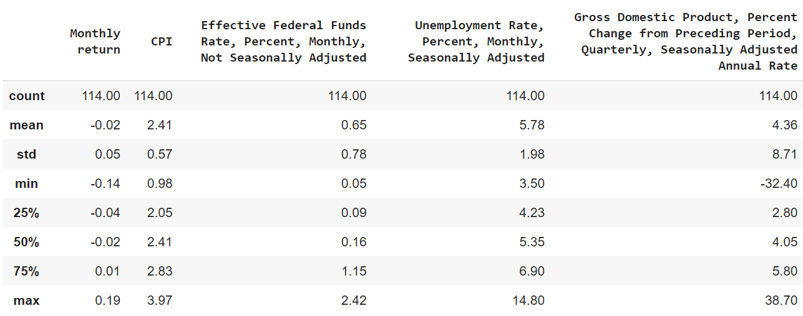
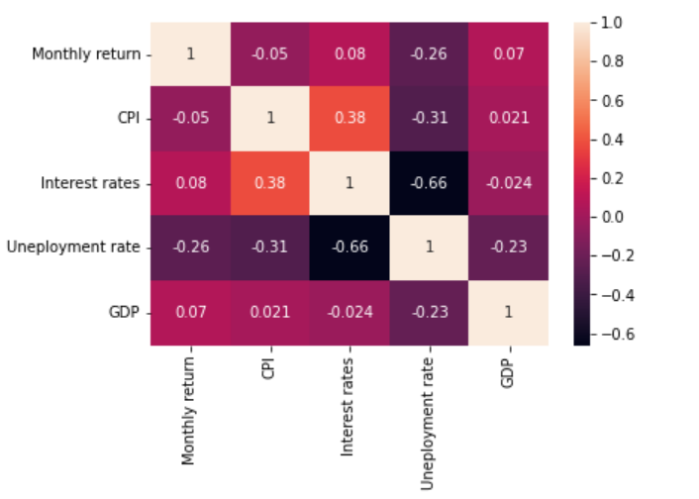
Dataset cleaning & Descriptive statistics
1. Convert Nadaq price into Monthly return
2. The dataset has been analysed using mean, variance, max & min to check for outliers
3. GDP & Interest rates are slightly correlated to Monthly return while CPI & Unemployment not

Slide 4
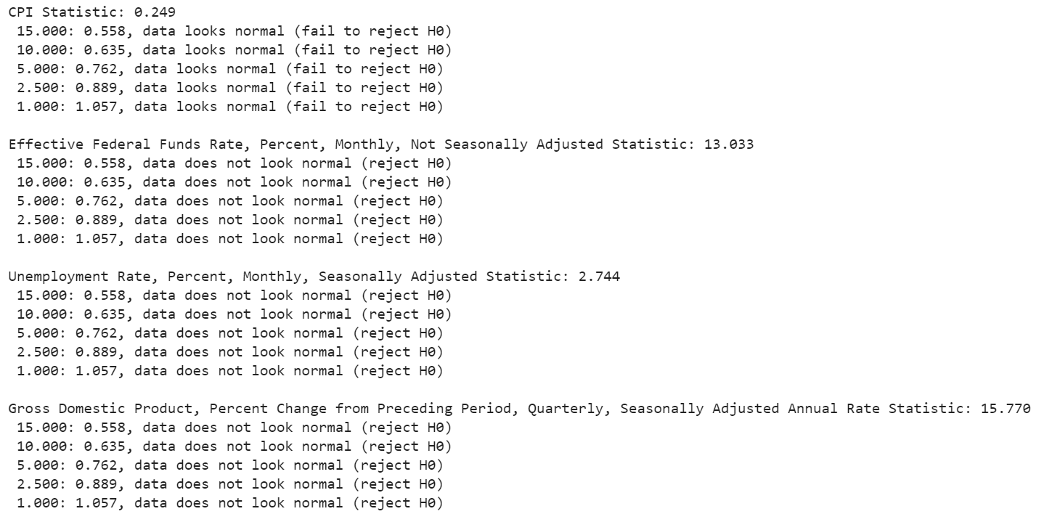
Normality test
- We performed normality test for each independent variables to check if a sample could have been dreaw from a normal distribution
We used the Anderson-Darling Test which returns a list of critical values rather than a single p-value.
We double checked with a D’Agostino and Pearson’s test, which test also for skweness/Kurtosis
Only for the CPI the Hypothesis H0 (sample comes from a Normal distribution) can be resjected.

Slide 5
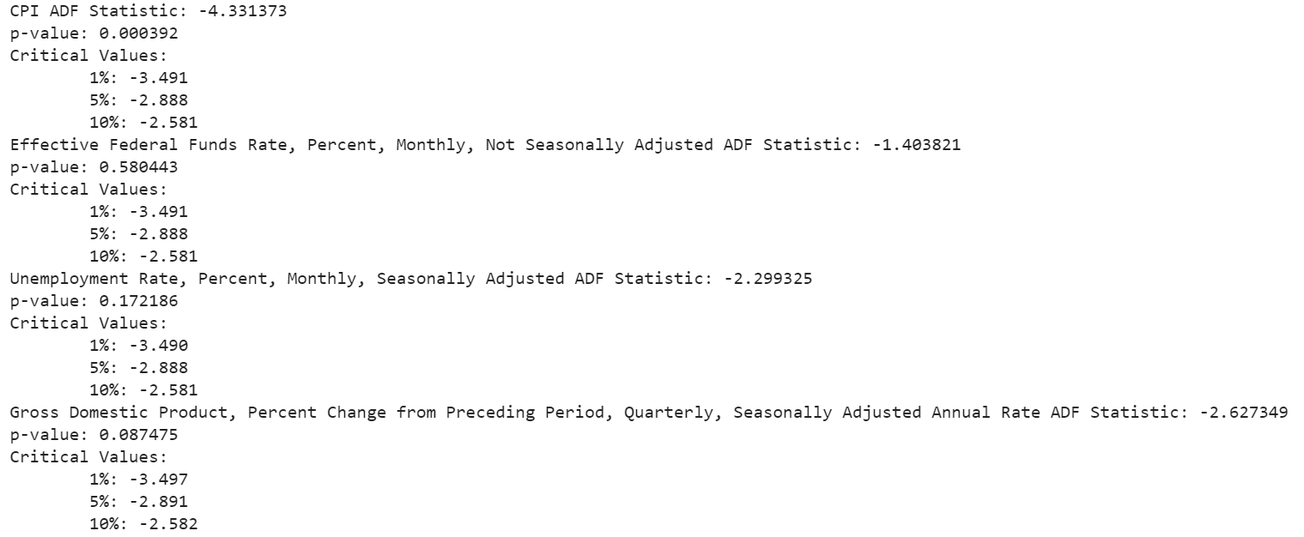
Test for stationarity
It is essential to confirm the order of integration of the variables before the model is estimate. We tested for stationarity using the Augmented Dickey-Fuller test.
We did log transform the dataset to make the distribution of values more linear
The results suggests we can that we can reject the null hypothesis for the CPI. Unit root is present for Fund rate, Unemployment and GDP
We used first-difference to make the series stationary

Slide 6
Linear regression – parameters estimation
A first simple implementation of Linear Regression is using scipy stats Linear Regression method. We try to estimate and predict the output “Nasdaq price index” in function of three parameters
A second ML implementation has been carried out with metrics and scoring methods as MAE, MSE and R2 score has been used to evaluate the quality of the prediction
Slope: [-0.0110082 -0.00964777 -0.00012068] Intercept: 0.04830718077213596
Root mean squared error: 0.0023050413303214758
R2 score: 0.08388827555926948
Conclusion:…

Slide 7
Appendix - charts

Slide 8
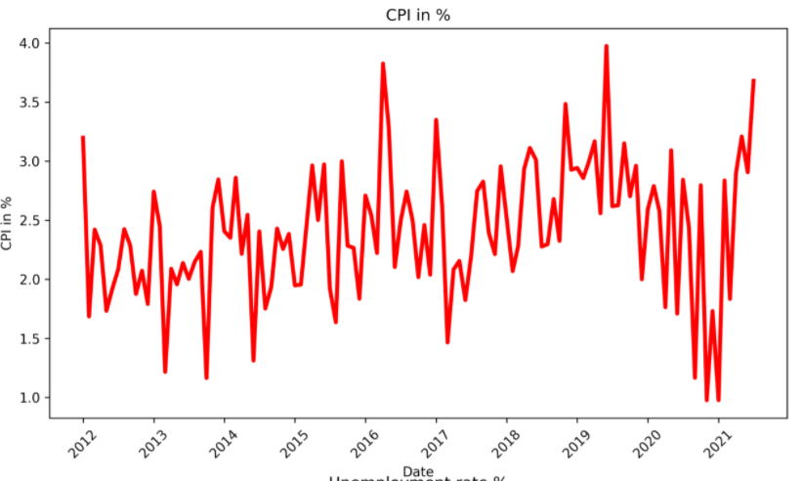
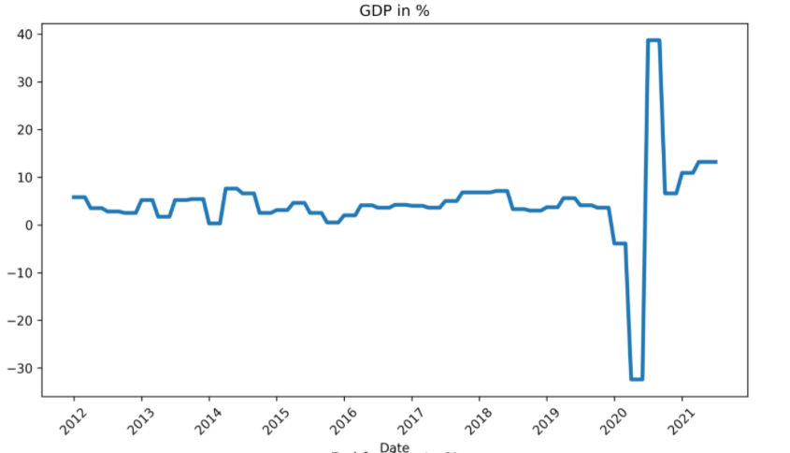
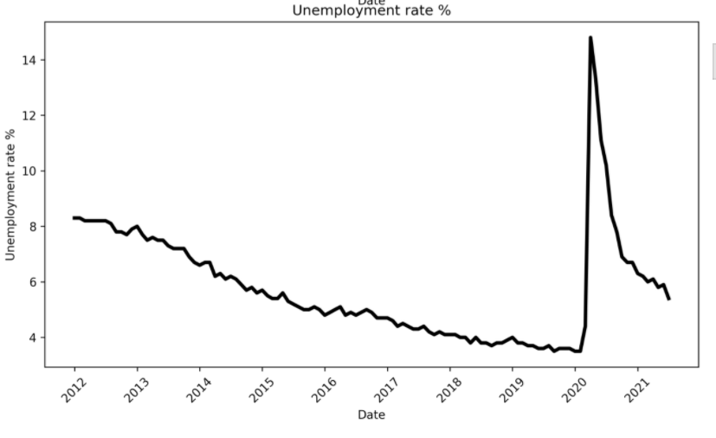
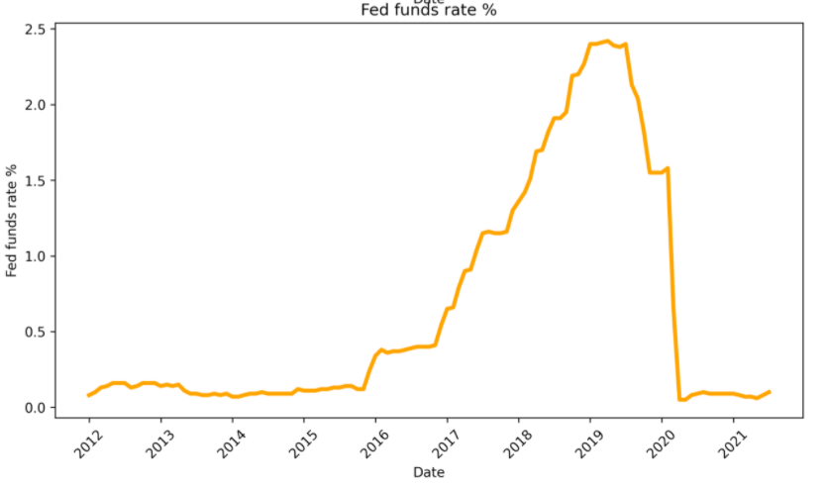
Independent variables

Slide 9
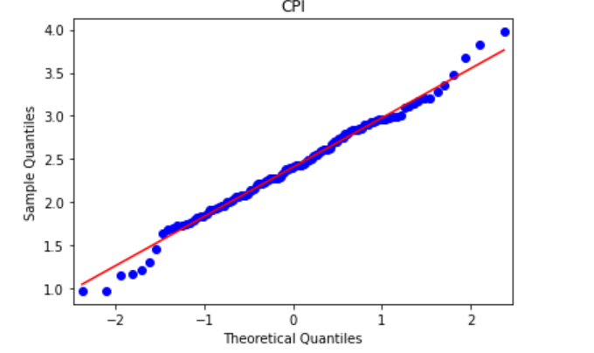
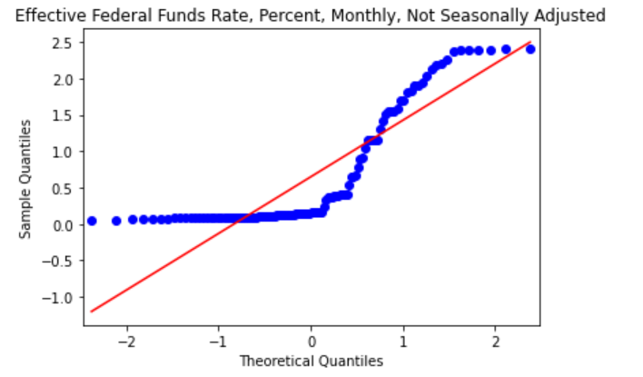
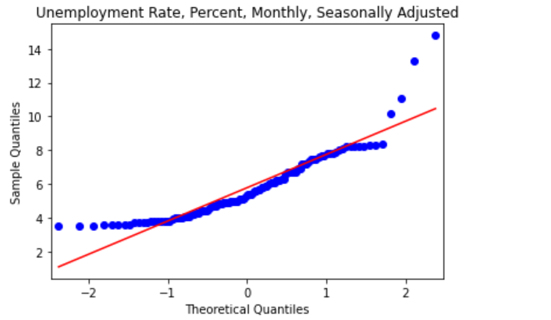
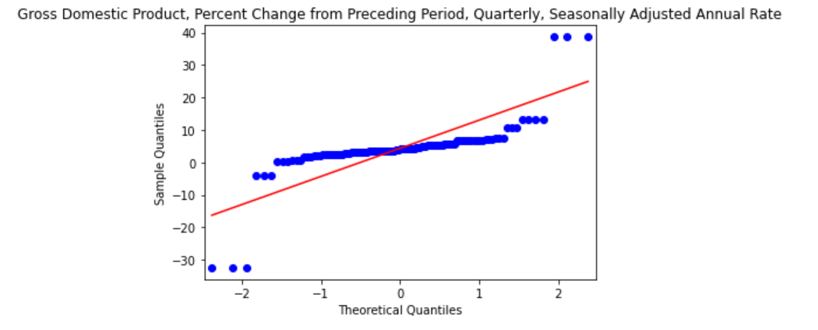
Independent variables distributions

